Slide 1


시각 Tech. 심화과정 (1) Lab session
연세대학교 컴퓨터과학과
오 승 욱

Slide 2
Contents
Tensorflow Basics
Basic operations
Layers
Workflow
Tips & Tricks

Slide 3
Contents
Semantic Segmentation
Framework
Network design
Try different networks
FCN
Hypercolumn
DeconvNet
Unet
Basics
Basic operations
Workflow
Layers
Semantic Segmentation
DeepLab
Feature Pyramid Nets
Sharp Mask
Global Convolution Nets

Slide 4
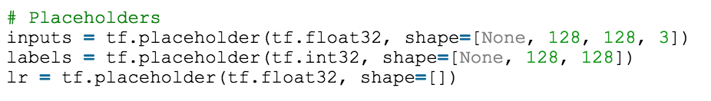
Placeholder
Make a dummy node with name
Usually used for inputs
Easily feed data by name
Tensorflow expect value for placeholder is provided by user at runtime
Only if the inference requires the placeholder
Tips: you can feed every node that is not placeholder

Slide 5
Layers
Operation + (optionally, Weights)
Operations: convolution, pooling
Weight: convolution filters, bias
No weights needed for pooling
What Tensorflow does
Build computational graph using [input, weight, operation, output]
Inputs
operation
outputs
Weight

Slide 6
Convolutional layer
Tensorflow 기반 convolution 구현
tf.nn.conv2d(input, filter, strides, padding, name)
Input must be a 4-D tensor ([batch, in_height, in_width, in_channels]
Filter/ kernel shape ([filter_height, filter_width, in_channels, out_channels])
Strides: [1,1,1,1] -> no strides, [1,2,2,1] -> 2 strides
Padding: same, valid
Name: conv layer name
Notes:
learn how to describe the content of images

Slide 7
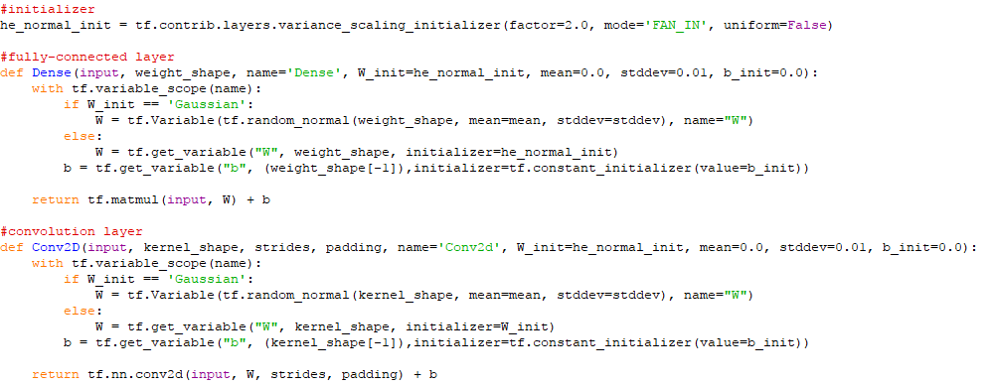
Convolutional layer
Notes:
learn how to describe the content of images

Slide 8
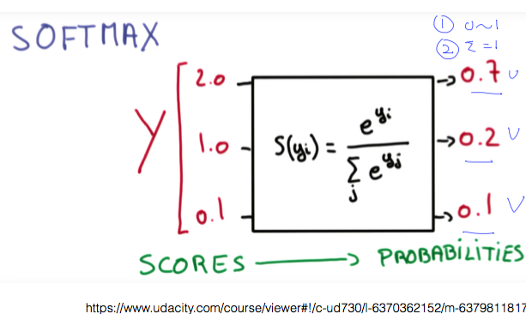
Cross Entropy
Softmax: Scores (logits) -> Probabilities

Slide 9
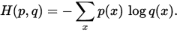
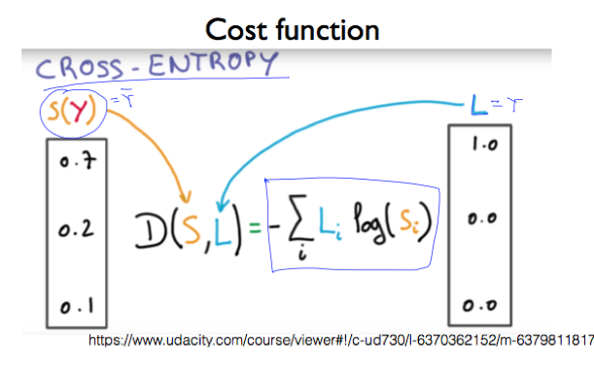
Cross Entropy
tf.nn.softmax_cross_entropy_with_logits

Slide 10
Cross Entropy
Semantic segmentation
Model performs classification every pixel
Cross entropy loss applied for every pixel

Slide 11
Optimizer
Takes Loss and parameter sets
Update given parameters to minimize loss
Tensorflow provided variety of Gradient based optimizer
SGD, RMSprop, AdaDelta, ADAM, etc
These days, ADAM seems to first-try option

Slide 12
Exercise: Semantic Segmentation
What I will provide:
Small version of Pascal VOC data and loader
VGG16 network and pre-trained weights
Very simple FCN* model
Goals:
1) Complete training script for simple FCN model
2) Build more complex / better model than FCN
3) Tune the training strategy to boost the accuracy
Fully Convolutional Networks for Semantic Segmentation
Jonathan Long, Evan Shelhamer, Trevor Darrell

Slide 13
Semantic Segmentation
Most model use image classification network pre-trained for ImageNet as a starting point
1) Use feature maps from pre-trained network
FCN, Hypercolumn, Deconvnet, U-net, etc
2) alter the network structures for pixel-wise estimation
Context Aggregation, Deeplab, etc

Slide 14
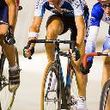
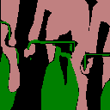
Semantic Segmentation
Problem definition:
Input: image
Output: pixel-level label map
Deep Network
Nx128x128x3
Nx128x128x21

Slide 15
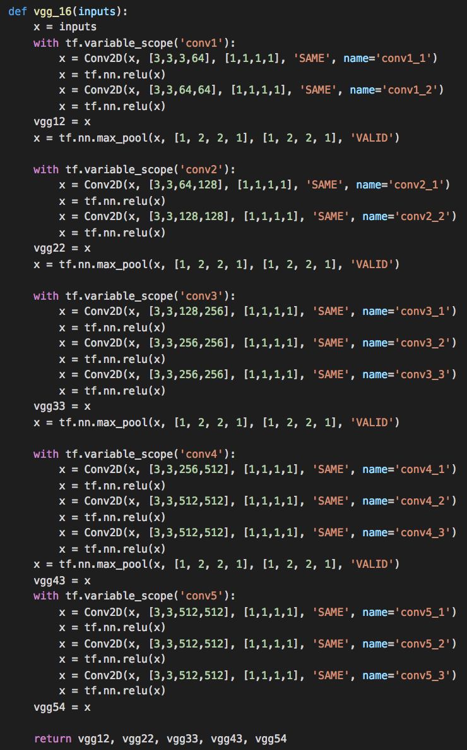
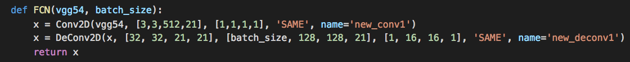
Simple FCN
Takes last convolutional feature map of VGG
Make prediction
Learn deconv. to resize

Slide 16
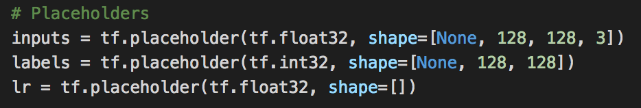
Workflow
Load training / test data
Define placeholders

Slide 17
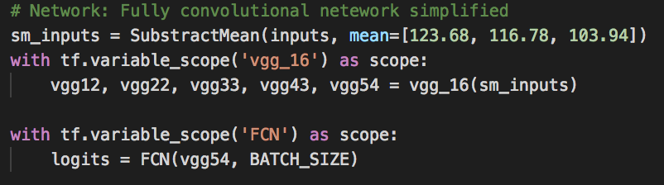
Workflow
Connect inputs and networks
Define output and metric

Slide 18
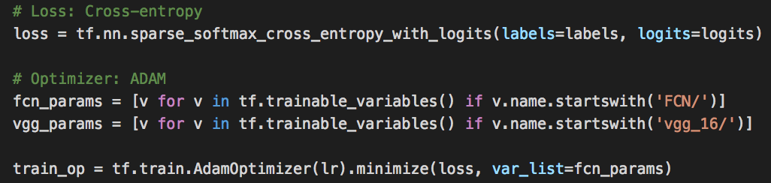
Workflow
Define loss and optimization operation
Update only FCN weights (VGG weigts are fixed)

Slide 19
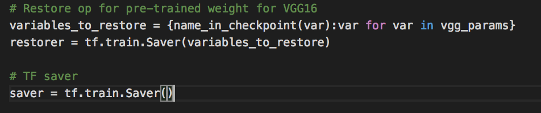
Workflow
Define Savers
One for VGG
One for entire weights

Slide 20
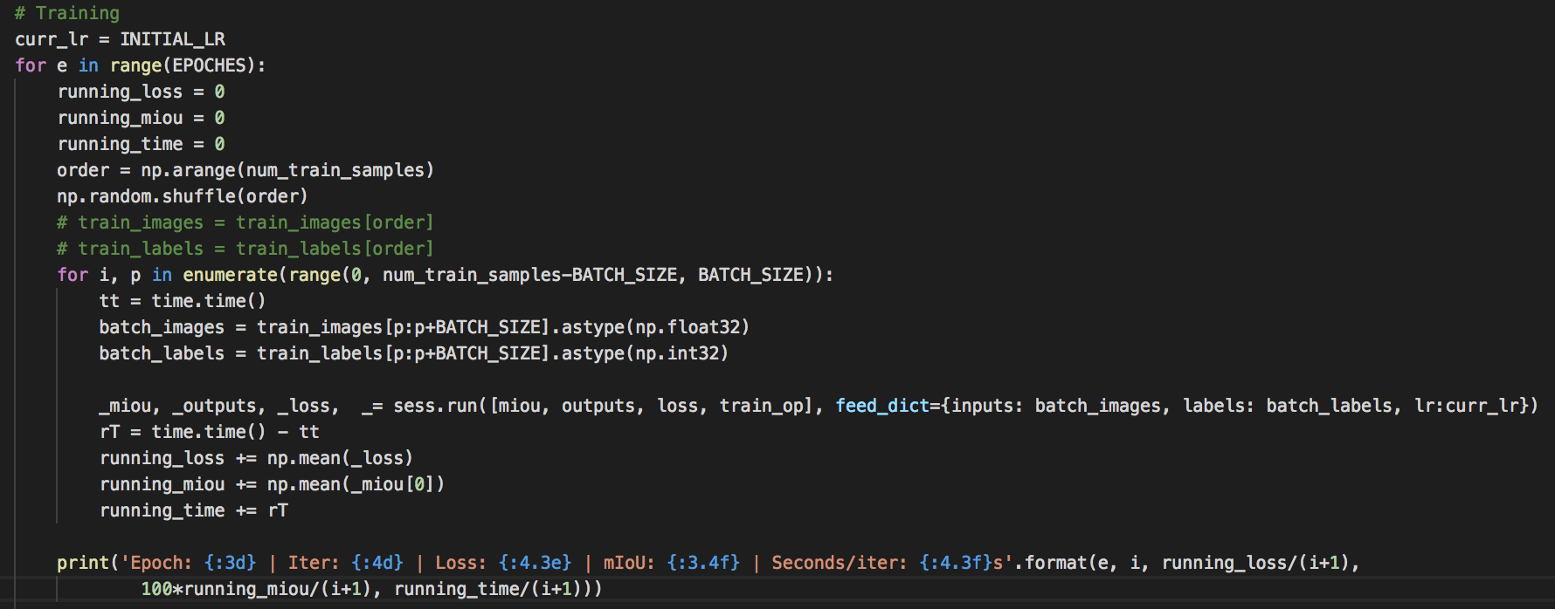
Workflow
Start training

Slide 21
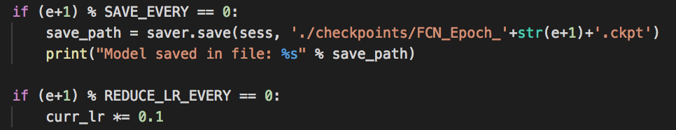
Workflow
Save weights and reduce learning rate

Slide 22
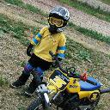

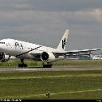
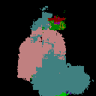
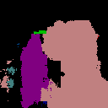
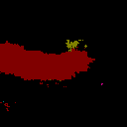
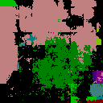



Results
Bad..? let’s make some improvement, then

Slide 23
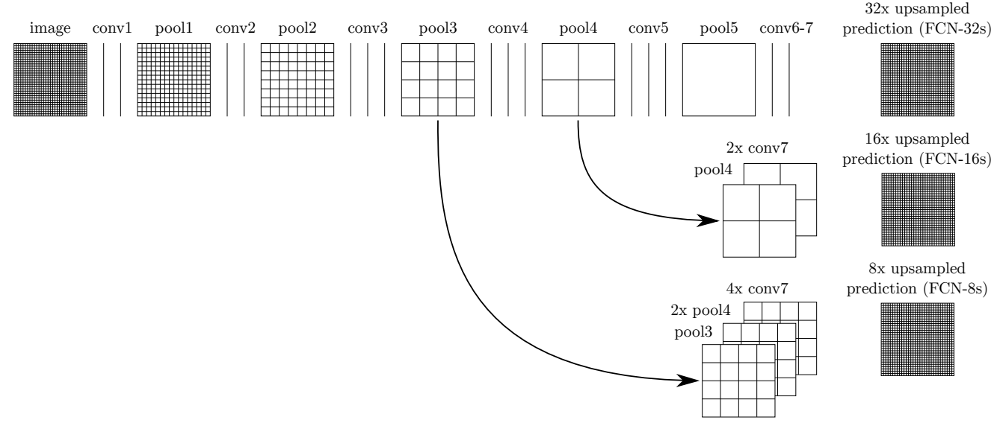
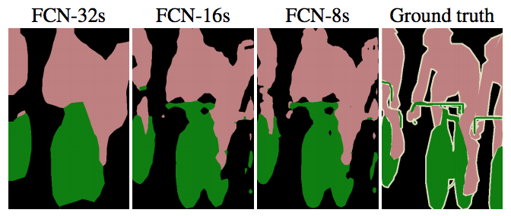
FCN
The original FCN
Fully Convolutional Networks for Semantic Segmentation
Jonathan Long, Evan Shelhamer, Trevor Darrell

Slide 24
FCN
The original FCN
Use information on lower-level feature map that comes with more spatial detail
Concatenate feature maps before deconv. Layer
Useful Tensorflow components
tf.image.resize_images resize feature maps with different size
tf.concat
Fully Convolutional Networks for Semantic Segmentation
Jonathan Long, Evan Shelhamer, Trevor Darrell

Slide 25
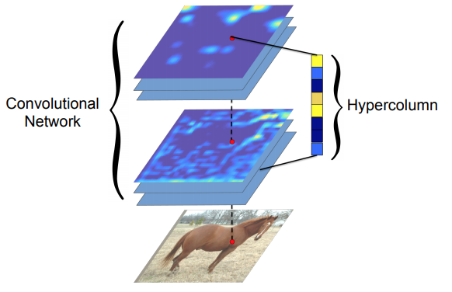
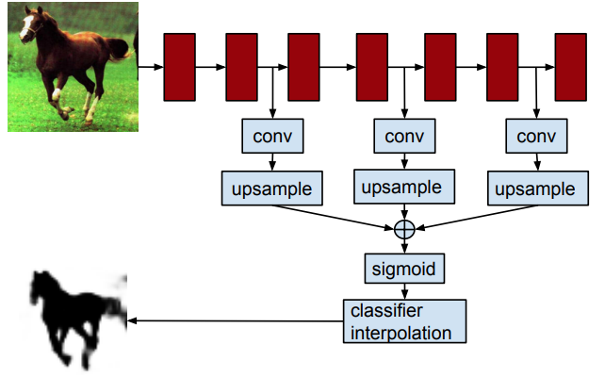
Hypercolumn
Similar to FCN
Reduce feature dimension using conv.
Stack more lower-level feature maps
Perfrom pixel-wise classification using 1x1 conv.
softmax
Hypercolumns for Object Segmentation and Fine-grained Localization
Bharath Hariharan, Pablo Arbeláez, Ross Girshick, Jitendra Malik

Slide 26
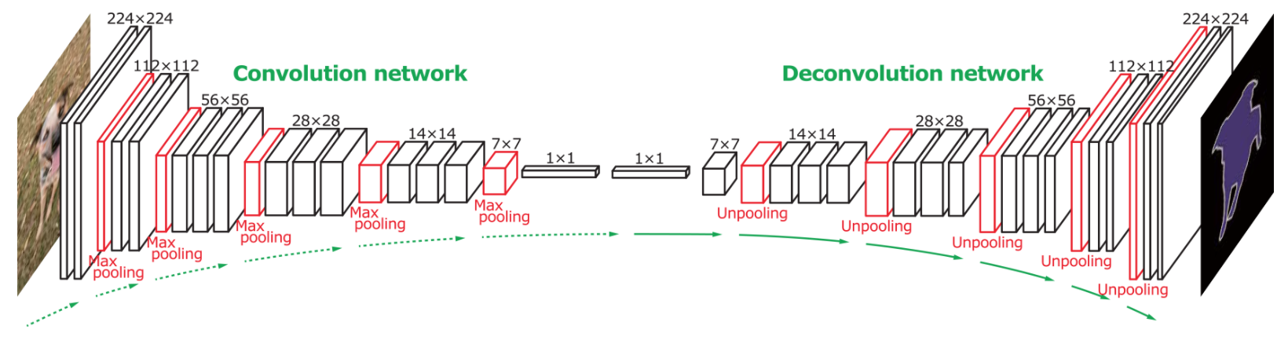
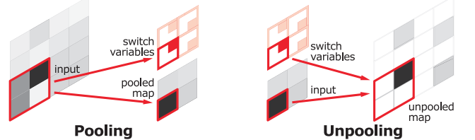
DeconvNet
Build Deconvolution network symmetrically to convolution network (VGG)
Replace unpooling with upsampling for easy implementation
Learning Deconvolution Network for Semantic Segmentation
Hyeonwoo Noh, Seunghoon Hong, Bohyung Han

Slide 27
U-Net
Similar to DeconvNet
Symmetrically concat. Intermediate feature map
U-Net: Convolutional Networks for Biomedical Image Segmentation
Olaf Ronneberger, Philipp Fischer, Thomas Brox

Slide 28
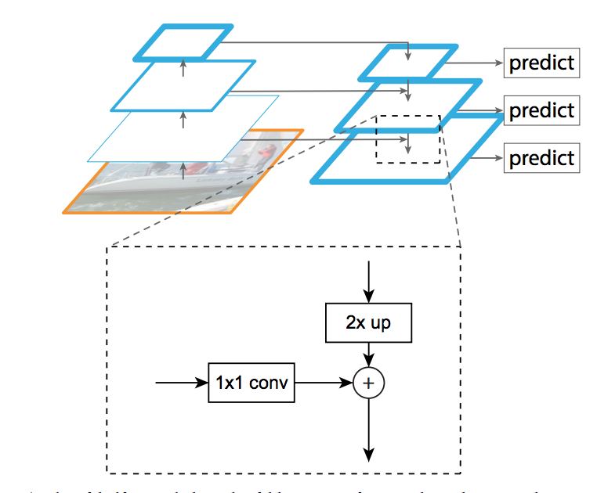
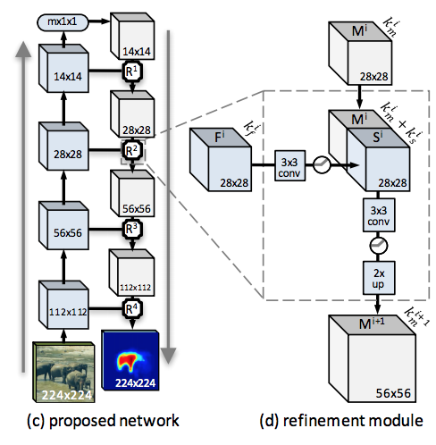
Feature Pyramid Network
Gradually aggregate multi-scale feature map
Similar to U-net but not symmetric
Learning to Refine Object Segments
Pedro O. Pinheiro, Tsung-Yi Lin, Ronan Collobert, Piotr Dollàr
Feature Pyramid Networks for Object Detection
Tsung-Yi Lin, Piotr Dollár, Ross Girshick, Kaiming He, Bharath Hariharan, Serge Belongie

Slide 29
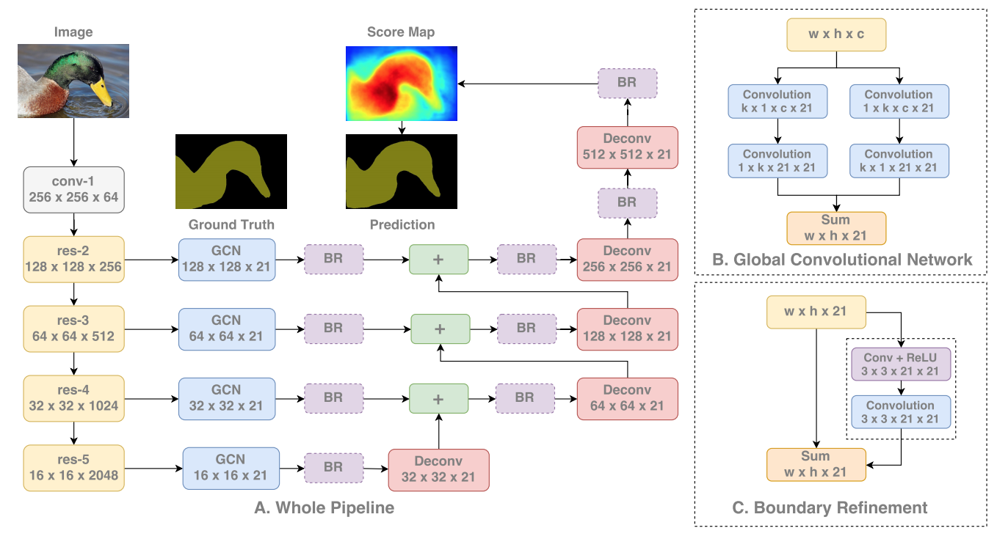
Global convolutional Network
To make more complex to have large receptive field
Large Kernel Matters -- Improve Semantic Segmentation by Global Convolutional Network
Chao Peng, Xiangyu Zhang, Gang Yu, Guiming Luo, Jian Sun

Slide 30
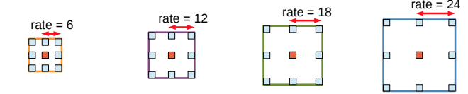
DeepLab (or dilated networks)
Directly Alter Base network structure
generate dense (pixel-wise) output not single classification
use weight pre-trained on ImageNet
Key component: atrous (dilated) convolution
Multi-Scale Context Aggregation by Dilated Convolutions
Fisher Yu, Vladlen Koltun
DeepLab: Semantic Image Segmentation with Deep Convolutional Nets, Atrous Convolution, and Fully Connected CRFs
Liang-Chieh Chen, George Papandreou, Iasonas Kokkinos, Kevin Murphy, Alan L. Yuille

Slide 31
DeepLab (or dilated networks)
Key component: atrous (dilated) convolution
Multi-Scale Context Aggregation by Dilated Convolutions
Fisher Yu, Vladlen Koltun
DeepLab: Semantic Image Segmentation with Deep Convolutional Nets, Atrous Convolution, and Fully Connected CRFs
Liang-Chieh Chen, George Papandreou, Iasonas Kokkinos, Kevin Murphy, Alan L. Yuille

Slide 32
DeepLab (or dilated networks)
Implementation
Replace VGG’s Convolutional layer with Atrous convolutional layer with appropriate dilation rate
Can be implemented easily similar to conventional Conv layer
tf.nn.atrous_conv2d
Remove pooling when conv. layer is dilated
If final output is smaller than the original size, bilinearly upsample it
tf.image.resize_images
Multi-Scale Context Aggregation by Dilated Convolutions
Fisher Yu, Vladlen Koltun
DeepLab: Semantic Image Segmentation with Deep Convolutional Nets, Atrous Convolution, and Fully Connected CRFs
Liang-Chieh Chen, George Papandreou, Iasonas Kokkinos, Kevin Murphy, Alan L. Yuille

Slide 33
Tips & Tricks
Learning rate
Batch size
Overfitting
Regularization
Data augmentation

Slide 34
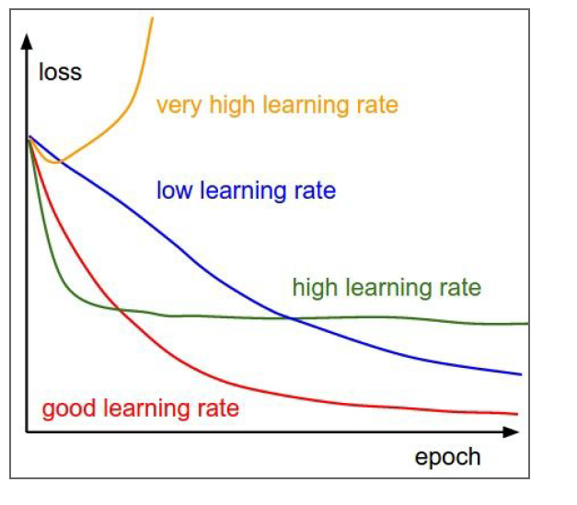
Learning Rate
First try default
Reduce if validation not getting better

Slide 35
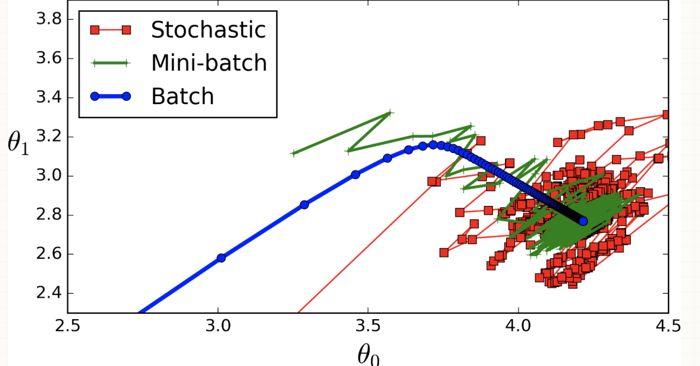
Batch size
+ Batch Normalization as Regularization

Slide 36
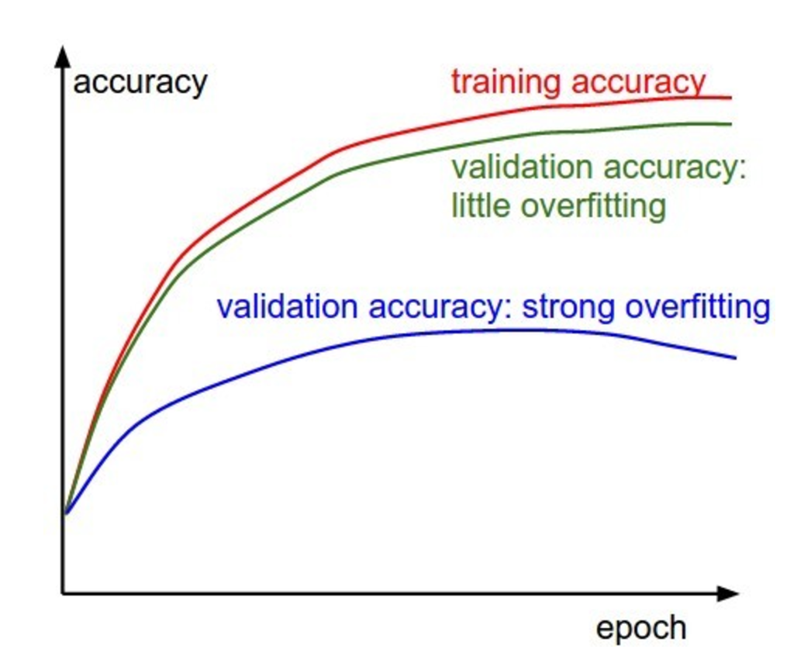
Overfitting
Keep track validation error

Slide 37
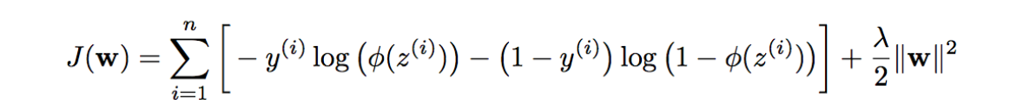
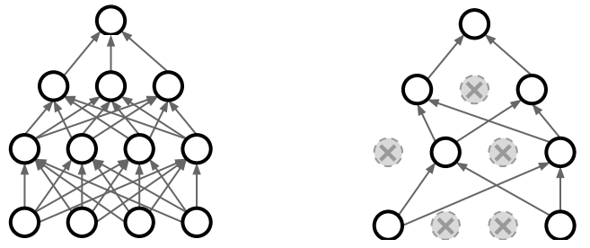
Regularization
Weight decay
Dropout
No dropout
Dropout applied
http://cs231n.stanford.edu/slides/2017/cs231n_2017_lecture6.pdf

Slide 38
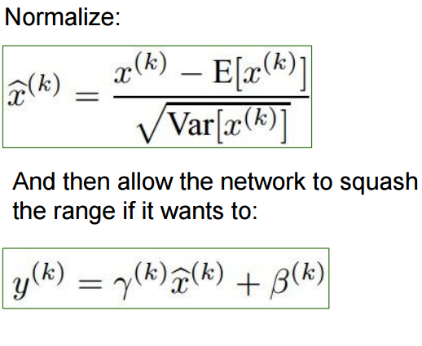
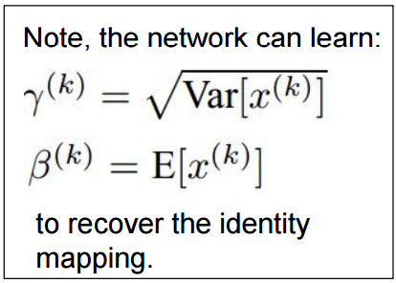
Batch Normalization
Learns gamma and beta
http://cs231n.stanford.edu/slides/2017/cs231n_2017_lecture6.pdf

Slide 39
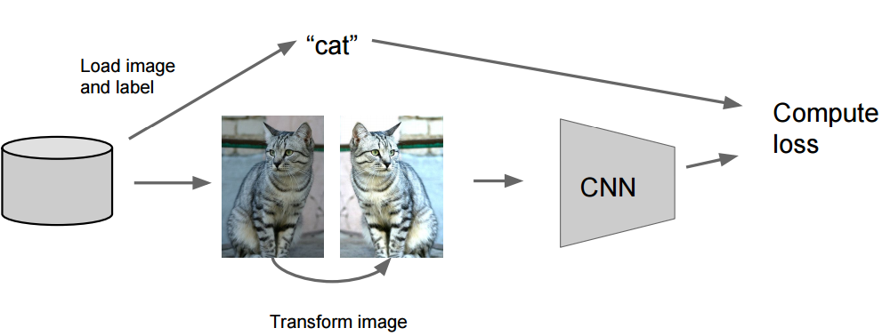
Data Augmentation
Scenario
Disk
Data augmentation
http://cs231n.stanford.edu/slides/2017/cs231n_2017_lecture6.pdf

Slide 40
Data Augmentation
Random mix/ combinations of:
Translation
Rotation
Scaling
Strecthing
Shearing
Distortion
+Add random noise
+ETC.
http://cs231n.stanford.edu/slides/2017/cs231n_2017_lecture6.pdf

Slide 41
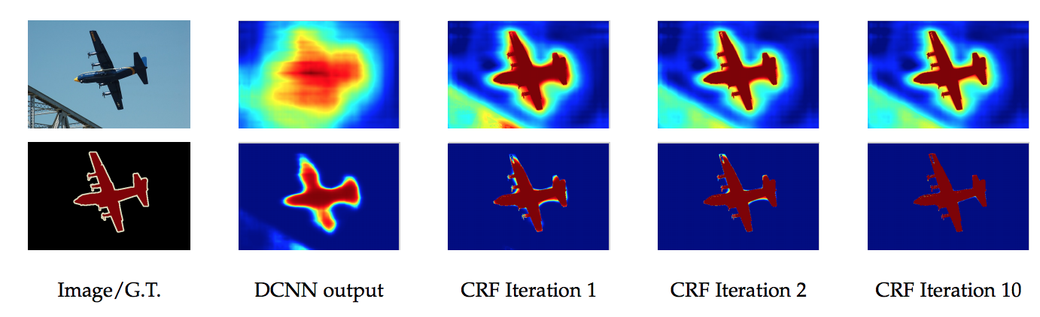
Post-processing
DenseCRF
See:
https://github.com/lucasb-eyer/pydensecrf

